Slide 1
Multi-Task Learning for Zero-Shot Hate Speech Detection in Low-Resource Languages
By: Aayush Kharwal, Kasyap Sai Chakkirala, Mitash Shah, Nirmal Malavalli Venkataraman, Shritej Patil

Slide 2
Motivation
Definition
Public speech that expresses hate or encourages violence towards a person or group based on something such as race, religion, sex, or sexual orientation.
Social Impact of Hate Speech
Hate speech severely threatens marginalized communities by deepening social divisions, fostering fear and hostility, and perpetuating harmful stereotypes and prejudices.
By effectively detecting and mitigating hate speech, we can try ensuring that all individuals, regardless of their background, feel safe at least in the digital world.
Notes:
The rapid proliferation of the internet across the globe has transformed online communication, introducing the significant diversity of our daily speech into the online discourse. This variety has also, unfortunately, led to an increase in hate speech. Say things, one would not in person
While Hate speech is a term with varied meaning and has no single, consistent definition. Cambridge Dictionary as -

Slide 3
Motivation
Challenges Faced by Detection Systems
Languages are often rich in idioms, slangs, and culturally specific references that can convey hateful sentiments in subtle and context-dependent ways.
Further, in low-resource languages, the paucity of annotated data hampers the ability to train models that can understand and interpret the nuanced expressions of hate speech.
And so, it’s no surprise that AI systems, including those designed for hate speech detection, often exhibit biases towards high-resource languages due to the abundance of data and research focused on them. This bias can result in subpar performance of low-resource languages, perpetuating existing inequalities.
Notes:
These intricacies require models to possess a deep understanding of not only the language but also the cultural contexts in which certain phrases and terms are used.
So, by developing models that cater to a wide array of languages, including low-resource ones, we can provide equitable safeguards across different communities.

Slide 4
Research Question
1. Can we build on the ability of multilingual models to understand low-resource languages for hate speech detection?
2. Does training on related languages impact the model's understanding of hate speech in low-resource language?
3. Can we expect any performance gains by training the model on related auxiliary tasks?
How does Multi-Task Learning for Zero-Shot Hate Speech Detection in Low-Resource Languages fare as compared to a fully trained model?
Footnote - Hindi as the choice of low-resource language
Notes:
What can we do? Are there certain techniques that we can employ, maybe in tandem, that would help us detect hate speech in low-resource languages? We break down this problem along three dimensions:
Internet India
Focus is not hindi but the methodology
Hindi is one of the most widely spoken languages globally, yet it remains underrepresented in annotated datasets for tasks like hate speech detection. Its prevalence in online discourse and the increasing instances of hate speech in Hindi make it a critical focus for this research.
Additionally, Hindi’s linguistic diversity and similarity to other Indo-Aryan languages make it an ideal candidate for studying cross-lingual and multi-task learning methods. Finally, there has been research on it so it gives a good repertoire of papers.

Slide 5
2.1 Multilingual Model
XLM-RoBERTa is a transformer-based multilingual language model developed by Facebook AI. It is an extension of RoBERTa, specifically designed for cross lingual tasks, and pre-trained on 100 languages using massive multilingual datasets.
Key Strengths
Applications
Handles morphologically rich and low-resource languages effectively.
Excels in capturing linguistic diversity through shared representations across languages.
Used for tasks like text classification, sentiment analysis, and hate speech detection in multilingual contexts
Notes:
XLMR is particularly effective in cross-lingual transfer scenarios, such as zero-shot and multi-task learning.
We trained XLMR on English data for Hate Speech and tested on Hindi data, to establish the baseline model for our task of cross-lingual hate speech detection.

Slide 6
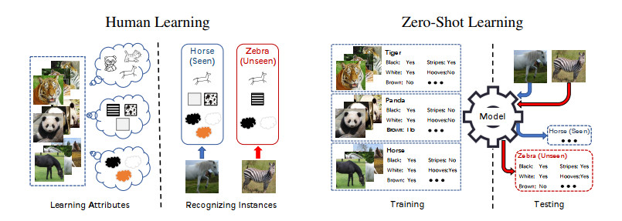
2.2 Zero Shot Learning
A machine learning paradigm where models generalize to unseen tasks or languages without explicit training on them.
Useful for low-resource languages like Hindi by leveraging high-resource language data.
Notes:
ZSL helps us bridge the gap when no training data is available for a specific language.
We hypothesize that training on related languages allows the model to leverage shared linguistic and semantic structures, which can enhance its ability to generalize to Hindi. Languages with similarities in morphology, syntax, or cultural contexts, such as Marathi and Bengali, can provide transferable features that help the model better detect hate speech in Hindi, even without explicit training on Hindi datasets. This approach reduces the reliance on resource-heavy Hindi-specific data.

Slide 7
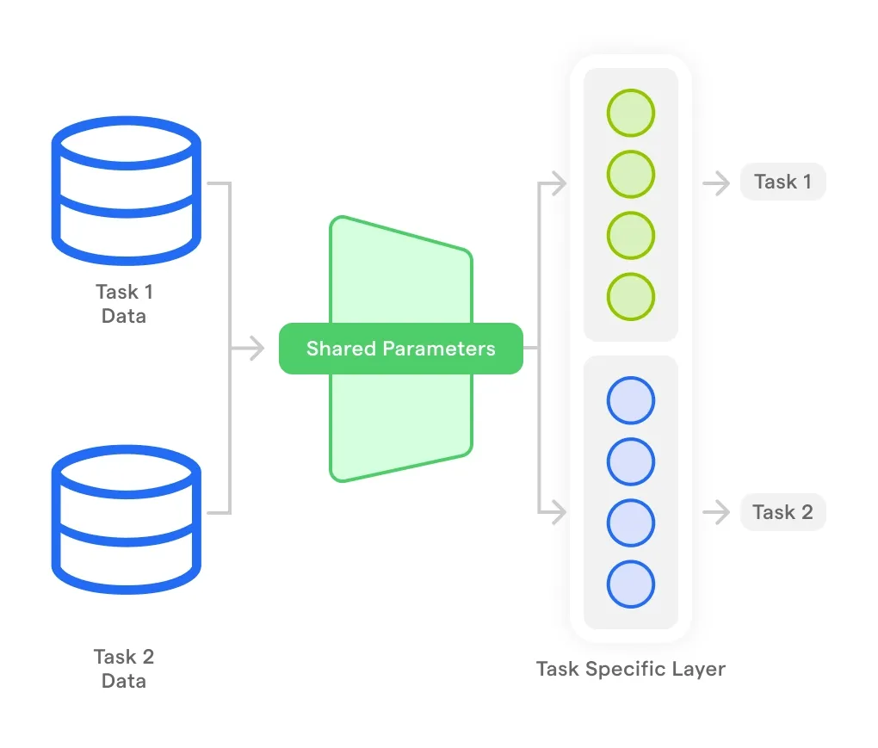
2.3 Multi-Task Learning
A framework where multiple related tasks are learned simultaneously to improve performance on the main task.
Enhances generalization by sharing representations across tasks.
Notes:
MTL allows a model to focus on one main goal while picking up helpful hints from related tasks.
Incorporating multi-task learning (MTL) with auxiliary tasks like sentiment analysis and offensive language detection enriches the model's contextual understanding.In research it has been shown that by learning shared representations across tasks, MTL reduces false negatives and better captures nuanced patterns of hate speech. Compared to the baseline single-task zero-shot model, this approach is hypothesized to typically result in improved performance metrics, as reduced loss, higher accuracy, and increased Macro F1 scores in cross-lingual evaluations.

Slide 8
Proposed Methodology
Zero Shot Learning
We fine-tuned a multilingual model, XLM-RoBERTa, on English and Marathi hate speech data and tested it directly on Hindi.
Multi-Task Learning
We added auxiliary tasks that share linguistic signals with hate speech detection to refine the model’s understanding. We weighted the tasks according to the priority, highest weight being assigned to Hate Speech Detection.
Offensive language detection
Is the language offensive, but not necessarily hateful?
Auxiliary Task 1
Hate Speech Detection
Primary Task
Sentiment Analysis
Does the text feel positive, negative, or neutral?
Auxiliary Task 2
Notes:
With specifics
The designed system does two things,
This dual strategy helps us balance the lack of Hindi-specific data while improving detection accuracy
Languages with similarities in morphology, syntax, or cultural contexts, such as Marathi and Bengali, can provide transferable features that help the model better detect hate speech in Hindi, even without explicit training on Hindi datasets. This approach reduces the reliance on resource-heavy Hindi-specific data.
The choice of Marathi is motivated by its similarity to Hindi, since they belong to the same family of languages, training the model on Marathi enables to model to learn nuances, which it would not have learned from English. Moreover, cultural nuances (think paper presnetation)
can reduce false nega-083
tives in hate speech classificatio
emotion detection086
tasks alongside hate speech detection could help087
the model capture emotional cues associated with088
hate speech, thereby improving performance on089
Spanish hate speech datasets.090
These tasks share linguistic signals that help the model detect hate speech more effectively. We gave more weight to the hate speech task to ensure it stayed our top priority while still learning from the others.
Constraint dataset

Slide 9
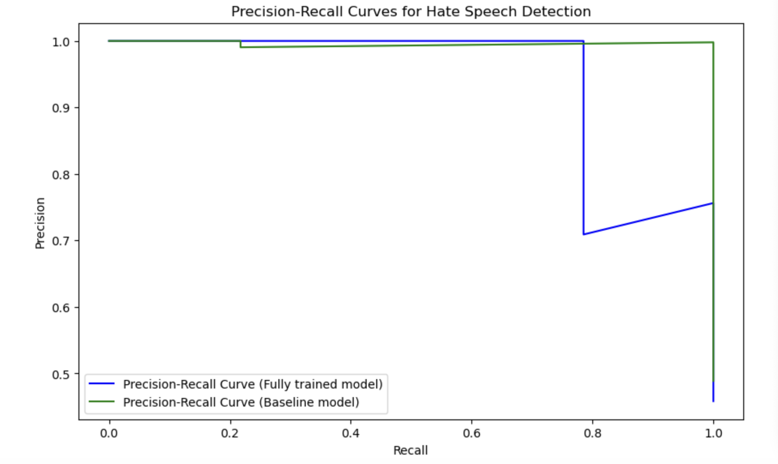
Findings So Far
Evaluation
F1-score balances the trade-off between Precision and Recall by providing a single metric, a harmonic mean of the two.
 | Hate Speech Detection | Offensive Language Detection | Sentiment Analysis
Baseline Model | 0.34 | - | -
Fully Trained Model | 0.75 | 0.82 | 0.56
Notes:
This being a classification task, we will be using ….
Simply stated, it tries to minimize the false positives (Precision) and maximize the true positives (Recall).
More informative than accuracy particularly in scenarios where the class distribution is uneven as it is not overly influenced by the majority class.
So, it provides a more holistic view of the model's performance which is crucial for tasks like hate speech detection, where correctly identifying all instances (high Recall) is as essential as ensuring that the identified instances are truly relevant (high Precision).

Slide 10
Conclusion and Q&A

